Slide 1

MESSAGE ENCRYPTOR AND DECRYPTOR
BY – Abhishek Verma
Roll no. – 2218177 (5)
Section – C2 (3rd Sem)

Slide 2

AGENDA
Introduction to encryption and decryption
Overview of encryption methods
Understanding decryption techniques
Types of Encryption Algorithms
Overview of Tkinter
Real World Applications
Conclusion

Slide 3

INTRODUCTION
In this presentation , we will explore the world of data encryption and decryption . We will uncover the methods and algorithms used to secure and protect sensitive information. We will explore the evolving landscape of security measures in the digital realm.

Slide 4
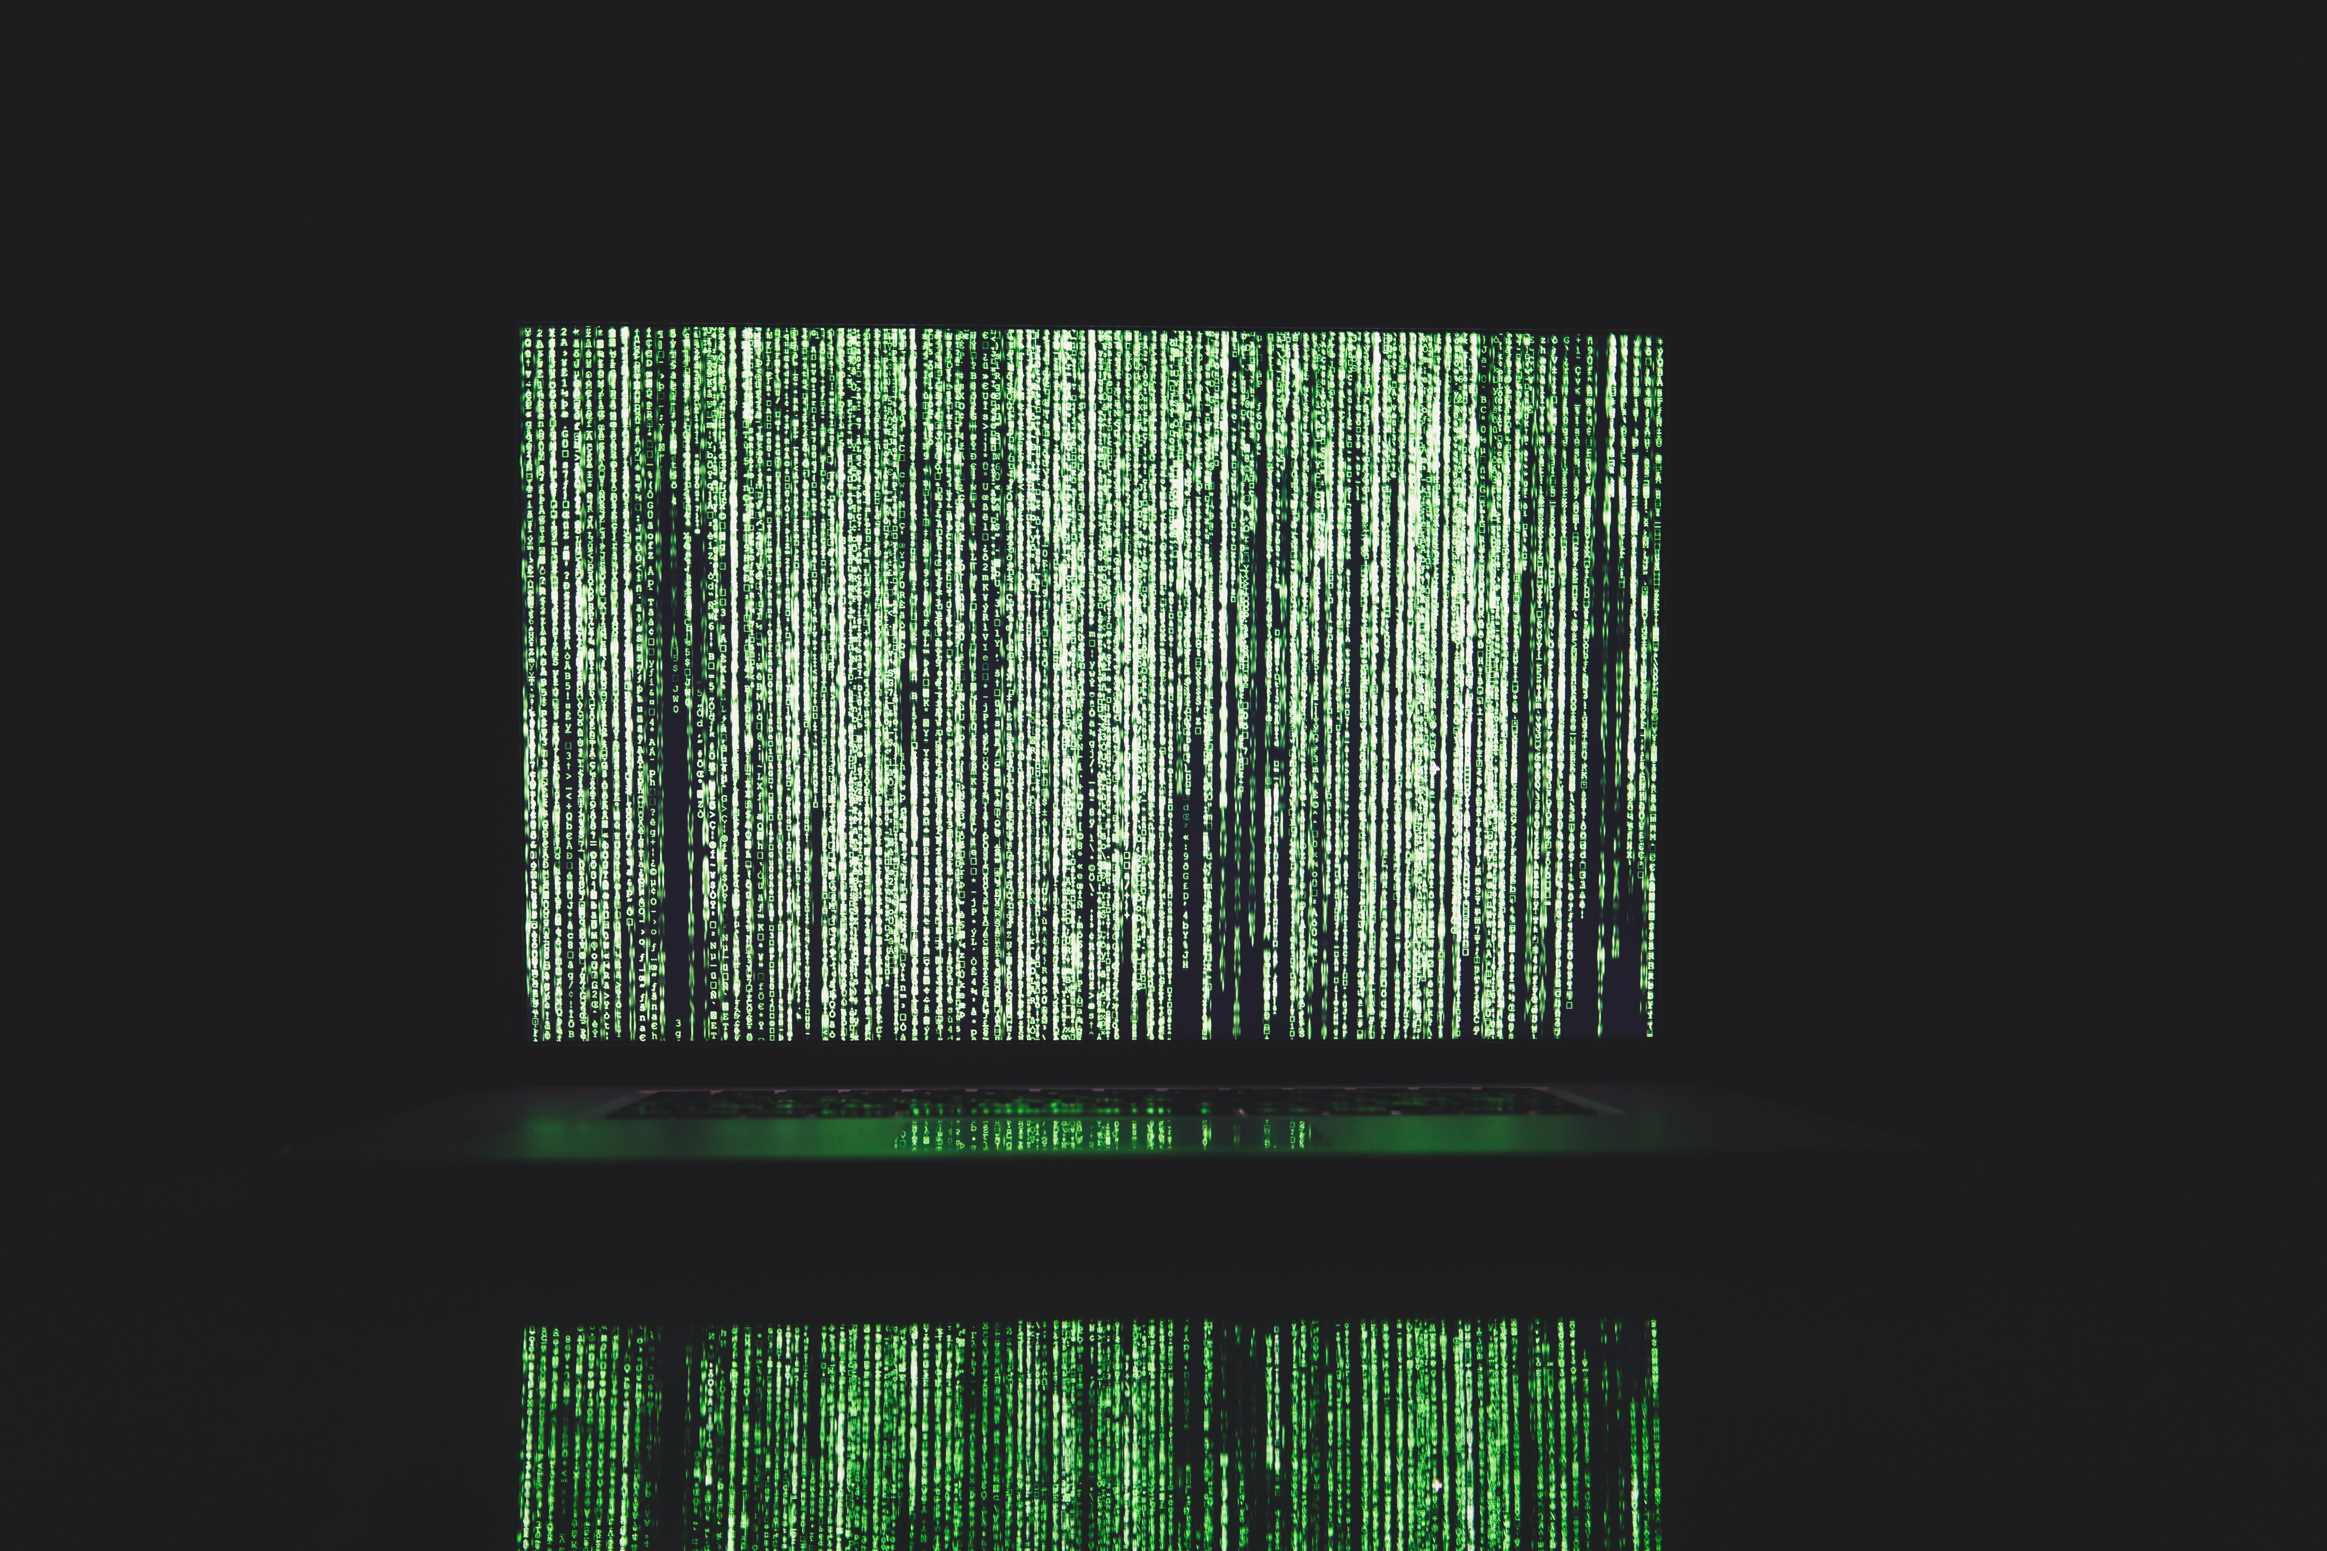
UNDERSTANDING ENCRYPTION
Encryption is a process of converting information, often referred to as plaintext, into a secret code or cipher, using an algorithm and a key. The primary purpose of encryption is to secure the data so that unauthorized parties cannot access or understand it. In other words, it involves encoding information in such a way that only authorized parties who possess the appropriate key can decode and understand the original data.

Slide 5

DECRYPTION
Decryption is the process of converting encrypted or encoded data (ciphertext) back into its original, readable form (plaintext). In other words, decryption is the reverse of encryption.

Slide 6

TYPES OF ENCRYPTION ALGORITHMS
There are different types of encryption algorithms ,including symmetric and asymmetric encryption. Each type has its own strengths and weaknesses, and is used in different scenarios.

Slide 7

ALGORITHM : SUBSTITUTION- PERMUTATION NETWORK
A Substitution-Permutation Network (often referred to as the SPN) is a network that takes in blocks of plaintext and keys , applies alternating rounds of substitution layers (S-boxes ) and permutation layers (p- boxes ) to produce the final ciphertext.

Slide 8
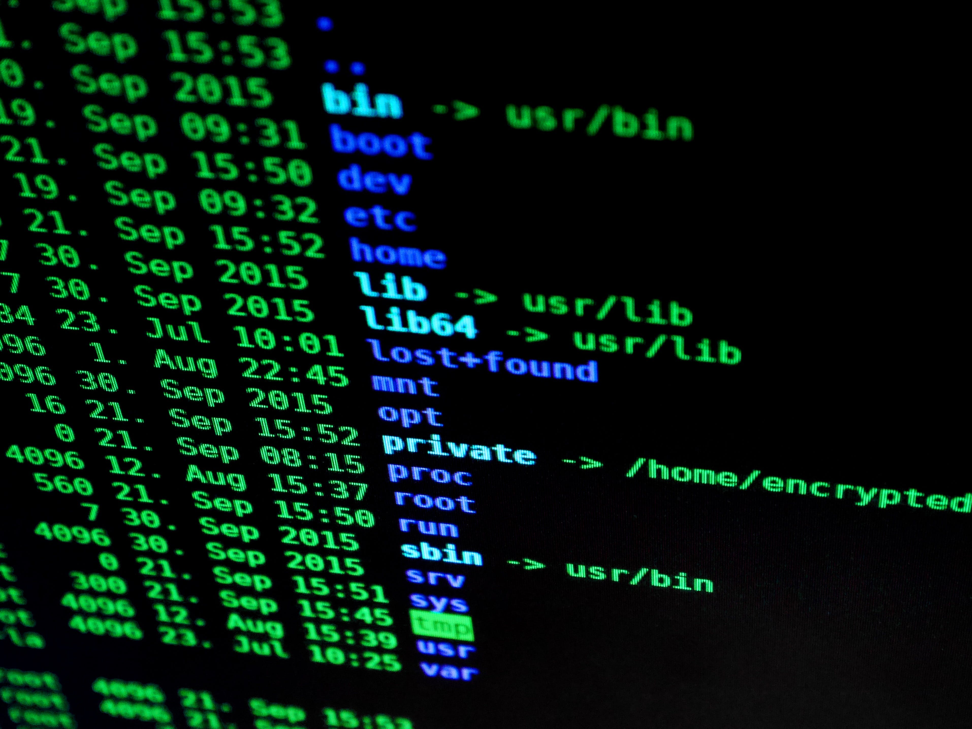
OVERVIEW OF TKINTER
Tkinter is a Python library that can be used to construct basic graphical user interface (GUI) Applications. In Python , it is the most widely used module for GUI applications.

Slide 9
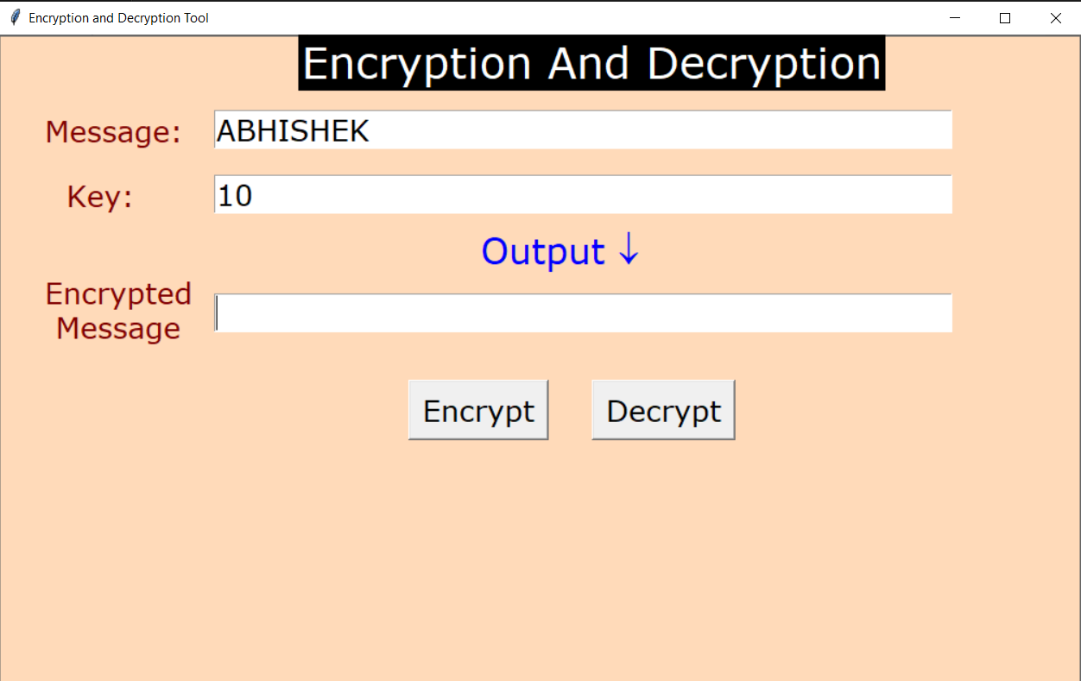
DEMONSTRATION OF THE MESSAGE ENCRYPTOR AND DECRYPTOR
Step 1: Run the Program Run the provided Python program in a suitable environment. This could be in a Python IDE or by executing the script in the terminal . Step 2: GUI Interface Upon running the program, a graphical user interface (GUI) window will appear. It's a simple window created using the tkinter library. Step 3: Input Message and Key In the GUI, you will see input fields for “Message” and “Key” . Enter the message you want to encrypt or decrypt in the "Message" field. Provide a key in the "Key" field. The key is used in the encryption and decryption process.

Slide 10
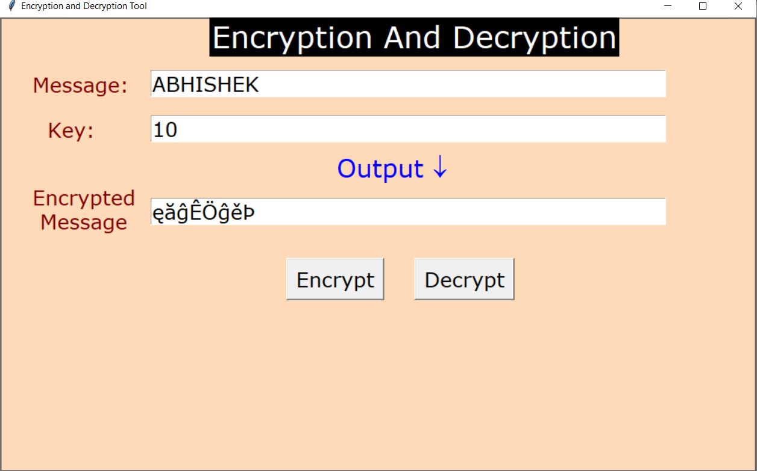
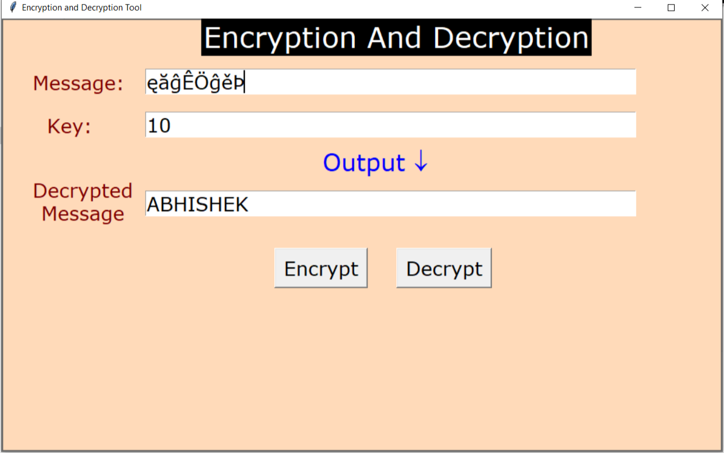
Step 4: Encryption Click the "Encrypt" button . The program will process the input message and key through a series of encryption steps, including substitution, permutation, and XOR operations.. The encrypted message will be displayed in the "Encrypted Message" section. Step 5: Decryption To decrypt the message, keep the encrypted messageas it is in the "Message" field. Enter the same key used for encryption in the "Key" field. Click the "Decrypt" button. Step 6: Close the Program Close the GUI window to exit the program.

Slide 11

REAL WORLD APPLICATIONS
Data encryption and decryption have widespread real-world applications, from securing financial transactions to protecting sensitive communications . We'll explore examples of encryption in action.

Slide 12

CONCLUSION
In conclusion, data encryption and decryption play a pivotal role in safeguarding sensitive information. By understanding the principles and best practices, we can ensure the integrity and confidentiality of data in an increasingly digital world.
THANKS!

